Slide 1

An Overview of Economic & Social Disparities in Ventura County: Focusing on Children, Housing, Employment & Income
by Jamshid Damooei, PhD
Professor & Chair
Department of Economics, Finance & Accounting
School of Management

Slide 2

Contents of presentation
An Overview
State of Children
Housing Affordability
Income & Employment
Conclusion and Ideas for Further Reflection

Slide 3
An Overview
The Core of Economic and Social Disparities in Our Society
Poverty is the core of disparity in every community.
Poverty in a society can be viewed as denial of opportunities to those in poverty to improve their economic & social status and living condition.
Despite some unexamined ideas poverty is not an inherent part of development of a person or an intrinsic characteristic of a group
Poverty is the direct product of the working of an economic system and social setting which themselves are impacted by the system.
Poverty among children and our inability to intervene through relevant and appropriate public policies will allow such condition to continue beyond current generation. That is why social mobility in the US is among the worst among developed countries (the irony of not being able to have American Dream)
The key in understanding and helping to meet such essential needs depends on activism and social movement to bring a change of heart and mind in our societies for design and execution of relevant public policies in all levels of government. This is the true promotion of social democracy in USA.

Slide 4
An Overview
Purpose of this Presentation
This presentation has the explicit aim of helping us to understand some of the prevailing realities of our communities in Ventura County.
The hope is to serve as a reference to bring our focus on various themes of this conference and hopefully along the way for creation of relevant public policies to reduce the negative impacts on our families who have been struggling to make the ends meet despite of living in one of the most affluent communities of Southern California.

Slide 5
State of The Children in Ventura County
Nurturing our children will prepare them for a much better life. A better life of individuals is the key for building better societies, avoiding poverty and increasing quality of life in our communities.

Slide 6
State of the children in Ventura County
In this section we used Misery Index to present the state of our children with particular emphasis on early childhood development.
What is Misery Index
It is an index which was created in a study for the First Five of Ventura County (thanks to Claudia Harrison) some five years ago with the aim of depicting the socio-economic condition of children in Ventura County.
The idea at the time was to use it for assessing the extent of the needs for NfL (Neighborhood for Learning) within the county for a better allocations of the scarce funds of the First Five.
We have made some changes since that time with regard to both collection of various indicators to reduce interdependence among the factors used in its construction and change of geographic locations from NfL to School Districts within the county. The latter one was to allow us conduct California wide research and not just for Ventura County.

Slide 7
Building Block of The misery index
It is an index presenting the Existing disparities in socio-economic conditions of children in a community.
Its value provides an expression of the living condition of children and it varies adversely with the wellbeing of children.
INCLUDES SIX INDICATORS:
Percentage of Poverty Among Children 5 Years and Under
Percentage of Female Households Below Poverty with Related Children at Age of 5 and Under
Percentage of Population 25 Years and Above without High School Diploma
Percentage of People at Age of 5 and Above who Speak English "Less than very Well"
Free and Reduced Meals
Percentage of English Language Learners

Slide 8
Misery Index in Ventura County School Districts
“Every child is an artist. The problem is how to remain an artist once we grow up”
Pablo Picasso

Slide 9
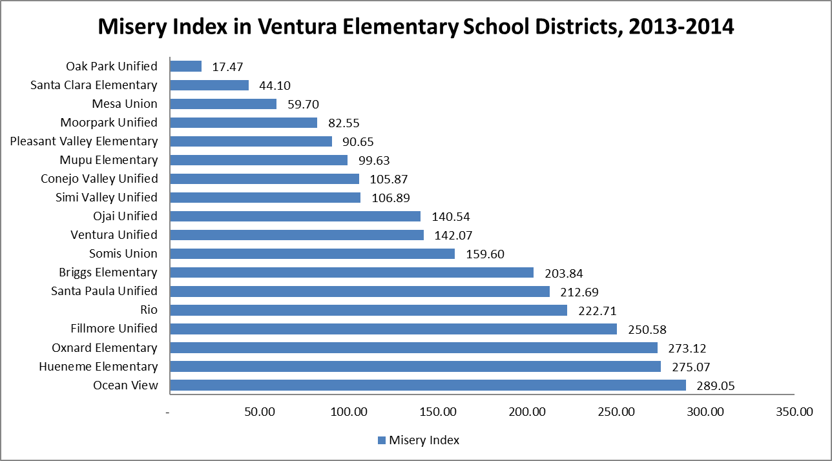
Source: Center for Leadership and Values

Slide 10
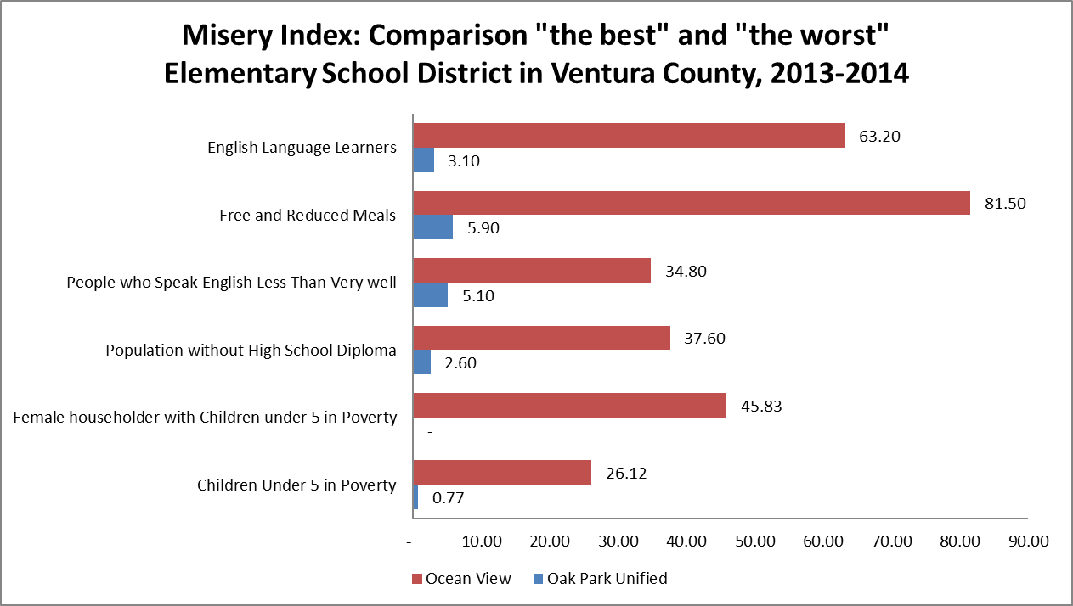
Source: Center for Leadership and Values

Slide 11
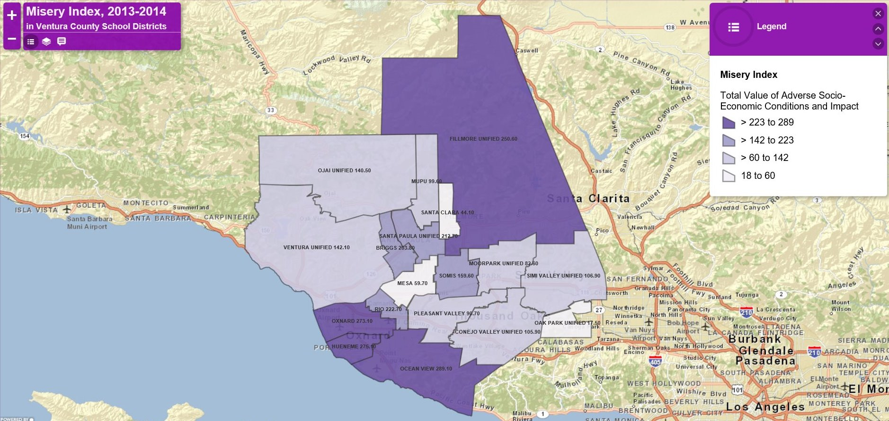
Geographic Distribution of Children Faced with Misery or Comfort Within Each County (Ventura)
Source: Center for Leadership and Values

Slide 12
Housing Affordability

Slide 13
Source: National Low Income Coalition, Out of Reach Report

Slide 14

Housing affordability in Ventura County, 2014
Have to Work more Than 40 Hours per Week to Afford 2 Bedroom Apartment – 76% (225,885 employees).
Have to Work more Than 60 Hours per Week to Afford 2 Bedroom Apartment – 48.9% (145,339 employees).
Have to Work more Than 80 Hours per Week to Afford 2 Bedroom Apartment – 15.3% (45,474 employees).
Source: Bureau of Labor Statistics

Slide 15
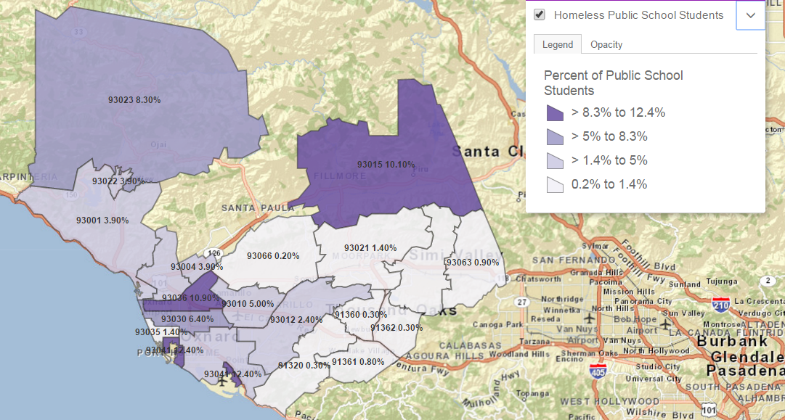
Homeless Public School Students in California, Ventura County and Ventura County Zip Codes, 2014
Percentage of Homeless Public School Students in 2014: Ventura County – 4.6% California – 4.8%
Source: A Program of Lucile Packard Foundation for Children’s Health

Slide 16
Income & Employment

Slide 17
Employment Status by Race and Ethnicity in Ventura County, 2014
Source: American Fact Finder, S2301

Slide 18
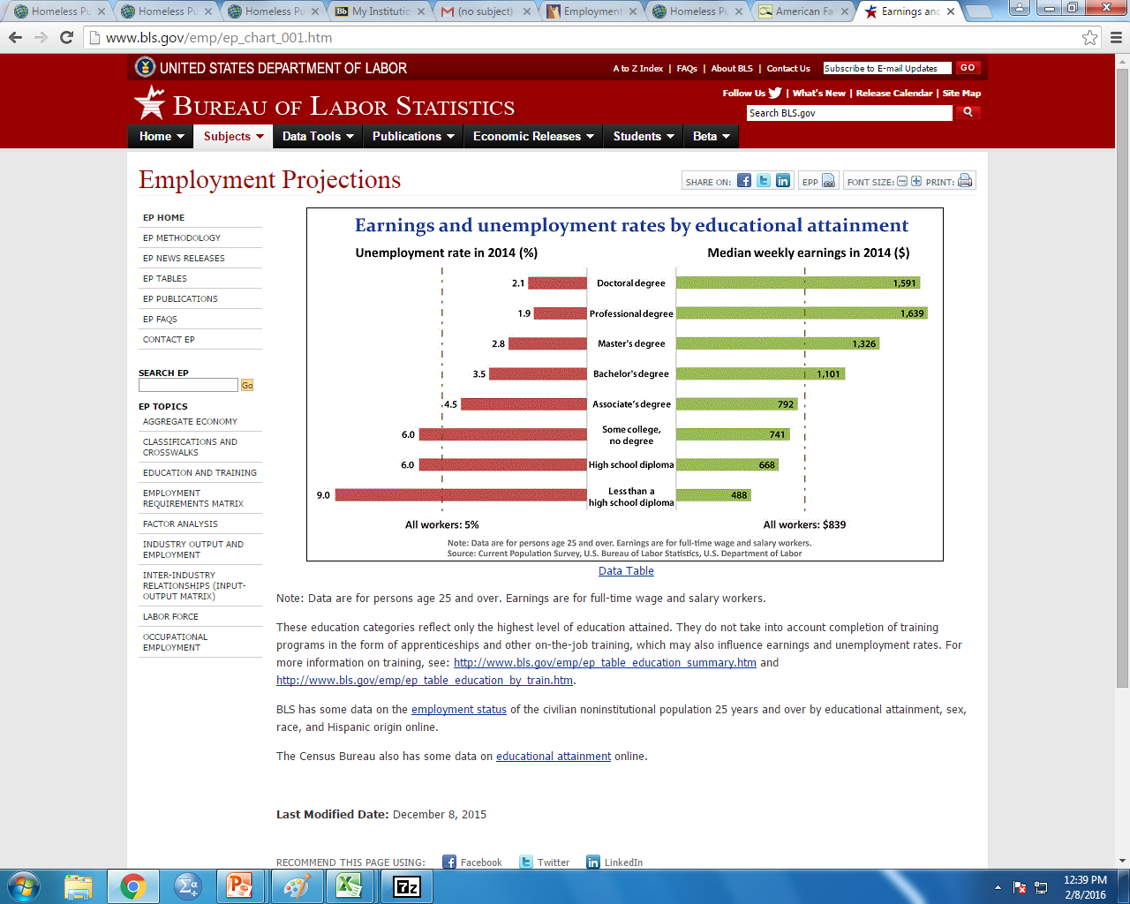
Earnings and Unemployment Rate by Educational Attainment in United States, 2014
Source: Bureau of Labor Statistics

Slide 19
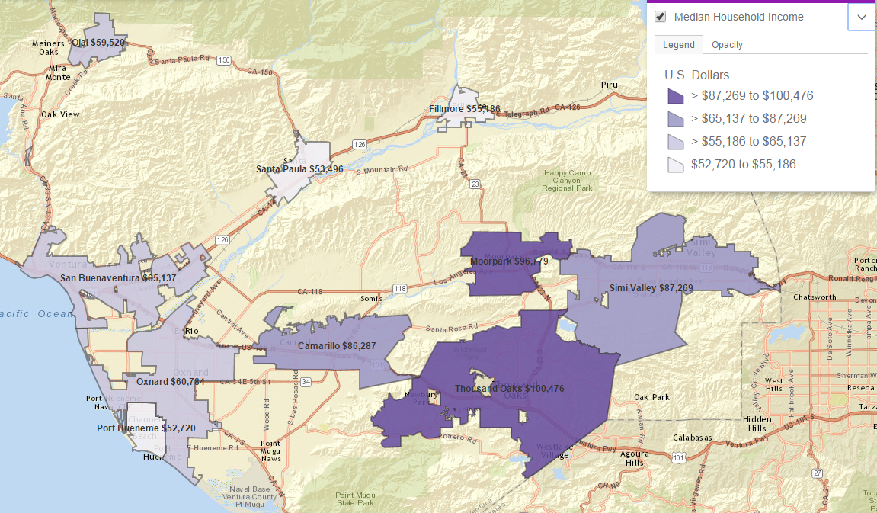
Median Income by Cities of Ventura County, 2013
Source: American Fact Finder, S1901

Slide 20
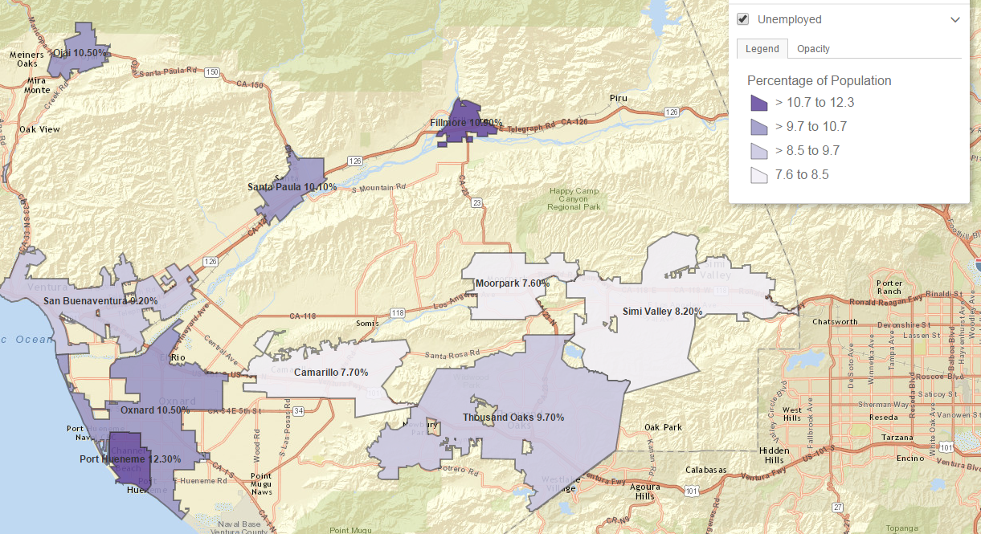
Unemployment Rate in Cities of Ventura County, Ventura County, California and United States, 2014
Unemployment Rate in 2014: Ventura County – 9.4% California – 11% United States – 9.2%
Source: American Fact Finder, S2301

Slide 21
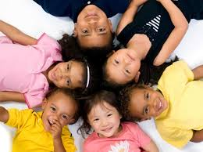
Median Income by Race and Ethnicity, 2013
Source: American Fact Finder, S1903

Slide 22
Other Selected Indicators of Disparity in Ventura County

Slide 23

Source: California Department of Education

Slide 24
Life Expectancy and obesity by Race and Gender in California, 2010 and 2012
Source: California Pan-Ethnic Health Network
Source: California Department of Public Health

Slide 25
Source: Ventura County Health Care Agency

Slide 26
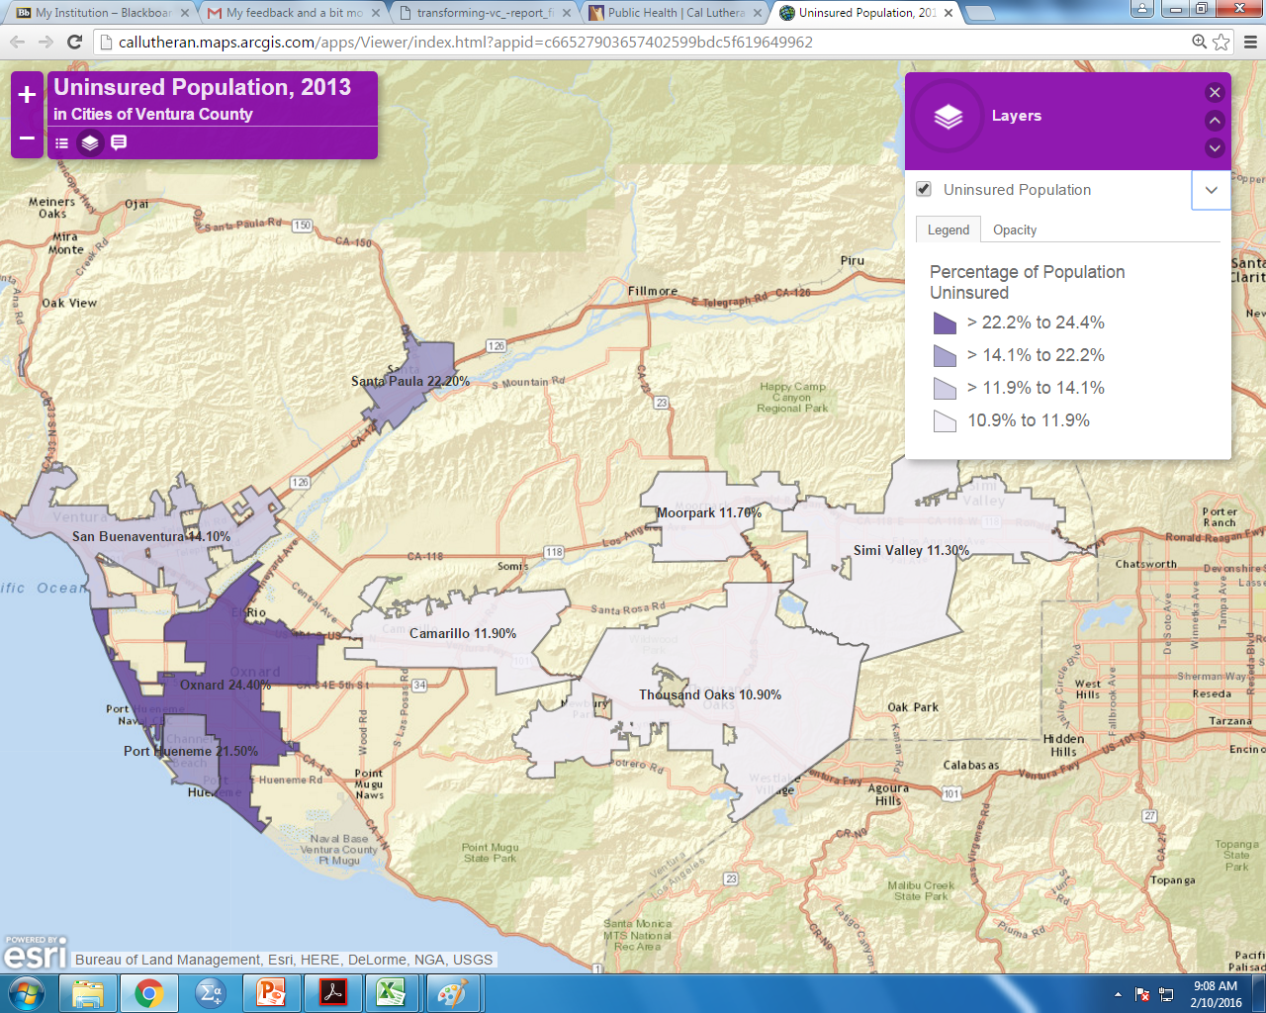
Uninsured Population in Cities of Ventura County, 2013
Source: American Fact Finder, S2701

Slide 27
Source: American Fact Finder, B24092

Slide 28
Conclusion and Possible Policy Implications
“

Slide 29

policy initiatives for Ventura county
Poverty is the core and the most important cause of the problem
Better utilization of existing resources with a focused attention on improving the performance of schools and their districts.
Increasing the degree of diversity in our schools through meaningful and applicable means.
Increasing investment in early childhood development through sustainable means and in various youth development Programs.
Focusing on what can be done to reduce the negative impacts of families in poverty and low income (food, healthcare, housing, education and safety).
Placing family as the centerpiece of any positive development that can occur.
Developing community based programs for any intervention that might be needed.

Slide 30


policy initiatives for Ventura county
Fostering greater partnership between local government and private sector for establishing high quality day care and early childhood centers for all working parents and particularly low income families
Looking into secondary and post-secondary education with the idea of creating functional pathways into establishment viable training for skill-sets needed for high paying jobs in the emerging 21st century job markets within Ventura County.
Putting the highest emphasis on Human Capital Development from early childhood.

Slide 31
Thank you!

