Slide 1


Oxford Program 2026
Office of Education Abroad

Slide 2


Program Structure
Program led by a selected faculty member from Cal Lutheran faculty who will direct a hybrid, semester-long course (four units).
First half in Oxford with two tutorials provided by Oxford University Faculty, referred to as “dons” (three units each for six total).
Second half in the bustling city of London, taking:
Two CIEE courses (in-person or virtual); or
One CIEE course (in-person or virtual) and an internship.
  (CIEE courses/internships are three units each)
Total of sixteen Cal Lutheran Credits

Slide 3

Fall 2026 Faculty Leader
"Dr. Dru" Pagliassotti teaches website design, film theory, film studies, news writing, and copy editing, and supervises student internships
Previously led the Oxford Program in Fall 2024
Dru Pagliassotti, Ph.D.
Professor, Communication
Xe/Xem, Dru/Dru’s, They/Them

Slide 4

Dr. Dru will lead a term-long CLU course
and will also be on-site to help navigate academics and life at Oxford.
CLU-Oxford Program Course
Imperial Ink: Comics and the Legacy of Empire
This course investigates the imagery of empire as it’s been presented in, and critiqued by, cartoons and comics, from late 19th-century colonialist cartoons in Punch magazine to propagandistic comic strips and comic books published during and after World War II to imagined empires in 21st-century fantasy and science-fiction settings. We will attempt to situate comics that engage in various ways with concepts of empire, colonization, resistance, and decolonization within a larger understanding of historical imperialist ideologies and events, and their lasting legacy on the way we imagine the world.

Slide 5


Slide 6


Oxford Tutorials
Tutorials are one don to one-to-four students.
Dons do not lecture: Students research independently and present papers for review. For a two-hour weekly tutorial, you can expect to spend twenty hours or more in preparation!
Preparation begins this spring, long before you arrive in Oxford.
Dates in Oxford: late August to late September
Potential Tutorial Topics:
International Law and Human Rights
Master Class on Shakespeare
International Social Injustice
Governing the Global Economy
Philosophical Topics
Landscape, Place, and Nature
Neuroscience
All tutorials satisfy the Upper-Division Honors Seminar requirement for Honors students.

Slide 7

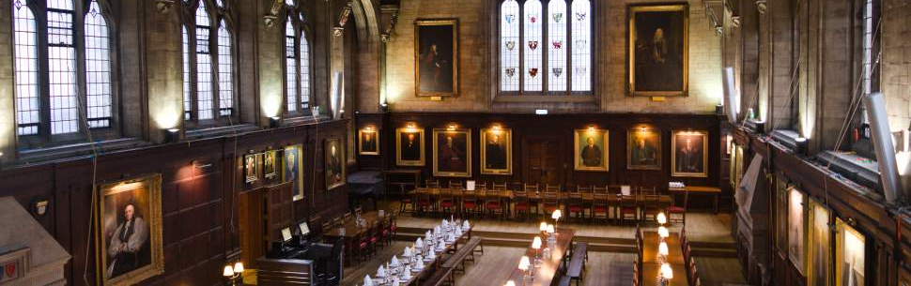
Life in Oxford
Reside in Balliol College
Breakfast and dinner in college hall included
Access to the Bodleian Library
Sample excursions include:
Stratford on Avon - Royal Shakespeare Company
Punting on the river
Ashmolean Museum

Slide 8


London
CIEE Global Institute in London
Located in Russell Square – next to the British Museum
On-site support by CIEE, local faculty teaching courses.
Time in London: late September to early November
Remember: the CLU course continues!
Option to take two courses or to participate
in one course with linked internship.
Course offerings vary, but a range of courses are offered, including public health, management, international relations, literature, environmental science, and communications.
Courses are usually twice a week, Monday-Thursday.
CIEE offers some optional excursions. The rest of your time is free to explore London!
Courses will be virtual or in-person, and you will join classmates from universities around the USA.

Slide 9

Life in London
Excursions included:
Two day trips
Two to three local excursions around London
London is a vibrant, international
city with so much to do!
You will live in a modern residence hall with kitchenette
CIEE is in Russell Square - easily within reach of the Tube (the subway) and the British Museum

Slide 10
Costs of Attendance
Students are responsible and manage costs related to travel, meals, books, and personal expenses. Below are estimates for consideration in planning your budget:
Meals in London are not included in program fee = $900-1,200
International Airfare = Approximately $1,300
Local Transportation = $200
Books & Supplies = $100
Personal expenses = $1,000-$2,500.
Costs vary depending on personal spending habits.
Cal Lutheran Tuition: All financial aid you receive is transferable (not including work study)
Housing: Grace/Trinity Rate
Meal Plan: Combo 50 meal rate
Airfare: Not included

Slide 11

Oxford Program Application
Open now on the OEA website
Application requires an essay question
Closes: November 1
OEA will interview select participants in November

Slide 12

Contact Us
oea@callutheran.edu
paglia@callutheran.edu
805.493.3750
@cluabroad

